Slide 1
BANKING BOT
CAPSTONE PROJECT
Presented By:-
Student Name- Gandhamalla Sai Vineeth
College Name- IMS University Course Campus, Ghaziabad
Department- BCA
AICTE ID- STU64da0d09e77091692011785

Slide 2
OUTLINE
Problem Statement (Should not include solution)
Proposed System/Solution
System Development Approach (Technology Used)
Algorithm & Deployment
Result
Conclusion
Future Scope
References

Slide 3
Problem Statement
Example: In today's fast-paced digital world, banking customers require quick, efficient, and reliable ways to manage their finances without the need for in-person visits to banks. Traditional banking methods often involve long queues, cumbersome paperwork, and limited operating hours, causing inconvenience and delays in financial transactions. As a result, there is a growing demand for a user-friendly digital solution that can provide immediate assistance for basic banking operations such as deposits and withdrawals.

Slide 4
Proposed Solution
To address the challenges faced by banking customers in managing their financial transactions efficiently, we propose the development of an AI-powered Banking Bot. The Banking Bot serves as a virtual assistant designed to facilitate seamless deposits and withdrawals through a conversational interface.
Key Features:
User-Friendly Interface: The bot offers an intuitive chat interface that mimics human interaction, making it accessible to users of all ages and technical proficiencies. Users can easily navigate the chat to perform banking transactions without needing extensive guidance.
Instant Deposits and Withdrawals: The Banking Bot enables users to perform deposits and withdrawals instantly, reducing the time and effort required to visit a physical bank branch. This feature is designed to cater to users who seek quick and efficient financial services.
Secure Transactions: To ensure user confidence, the bot incorporates robust security protocols, including authentication and encryption, to protect sensitive financial data and prevent unauthorized access. This ensures that all transactions are conducted securely and privately.
24/7 Availability: Unlike traditional banking services that operate during specific hours, the Banking Bot is available 24/7, allowing users to access banking services at their convenience, regardless of time and location.
Personalized User Experience: The bot leverages AI to learn user preferences and transaction patterns, providing personalized recommendations and assistance tailored to individual needs.

Slide 5
System Approach
System requirements
Processor Intel(R) Core(TM) i5-7400 CPU @ 3.00GHz
Installed RAM 8.00 GB
System type 64-bit operating system, x64-based processor
Pen and touch No pen or touch input is available for display
Technology used:
The IBM Jobs Chatbot includes setting goals, designing and developing the chatbot with IBM Cloud and WatsonX Assistant, and deploying it. After training HR teams, performance is monitored, and improvements are made based on feedback. The project’s impact is then evaluated and reported.

Slide 6
Algorithm & Deployment
Select Platform: Choose IBM Cloud or another suitable platform for hosting and managing the chatbot.
Design: Define the visual elements, including the color scheme and layout, to ensure a user-friendly interface.
Configure Q&A: In WatsonX Assistant, create intents to identify user queries and set up dialogues for responses in the Action tab.
Test: Use the Preview section to interact with the chatbot and validate that it responds correctly to various inputs.
Publish: Finalize and deploy the chatbot to the chosen platform, making it available for users to interact with.

Slide 7
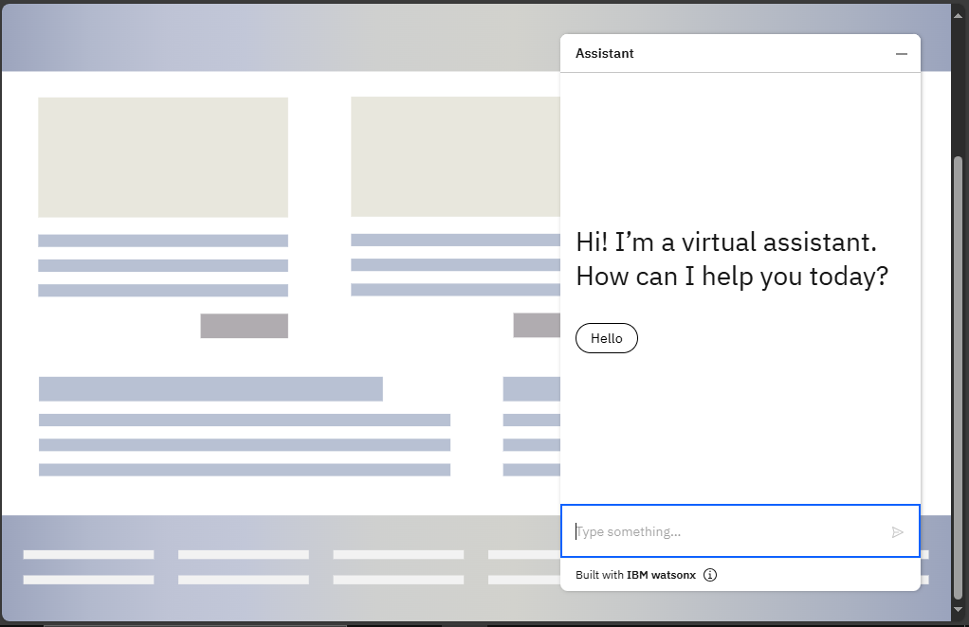
Result

Slide 8
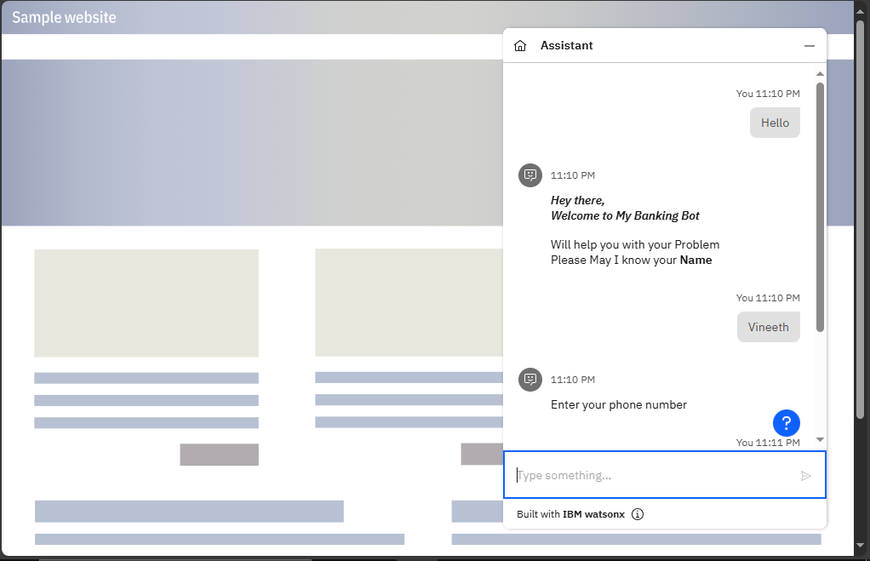
Result

Slide 9
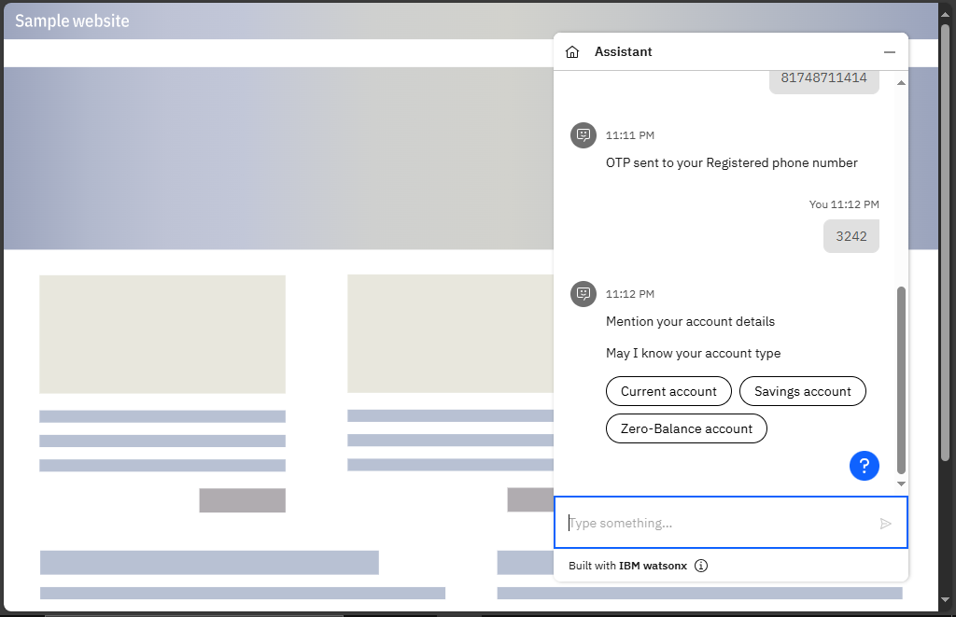
Result

Slide 10
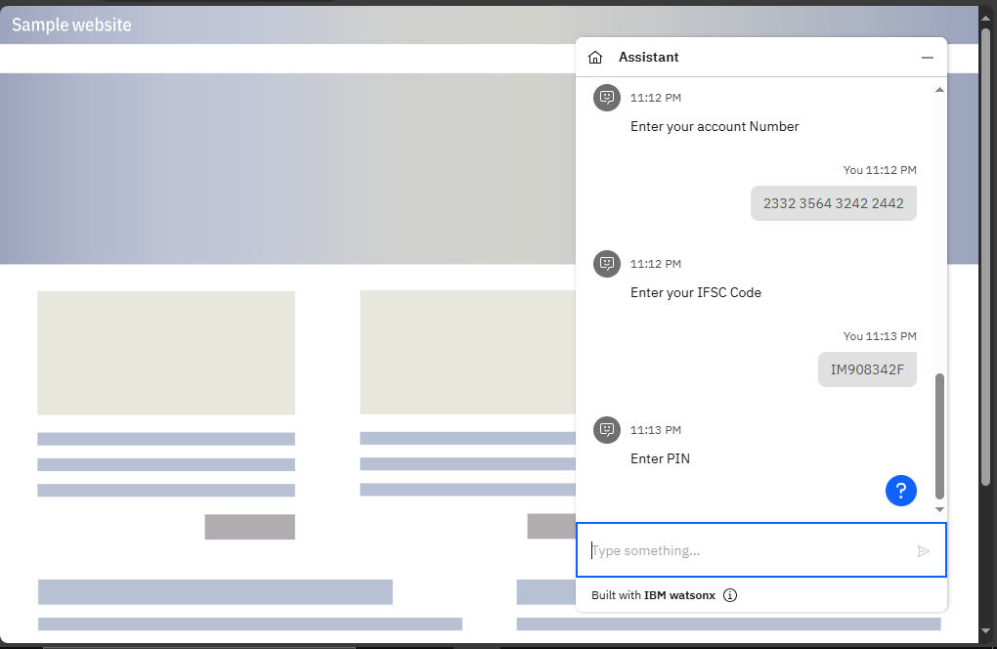
Result

Slide 11
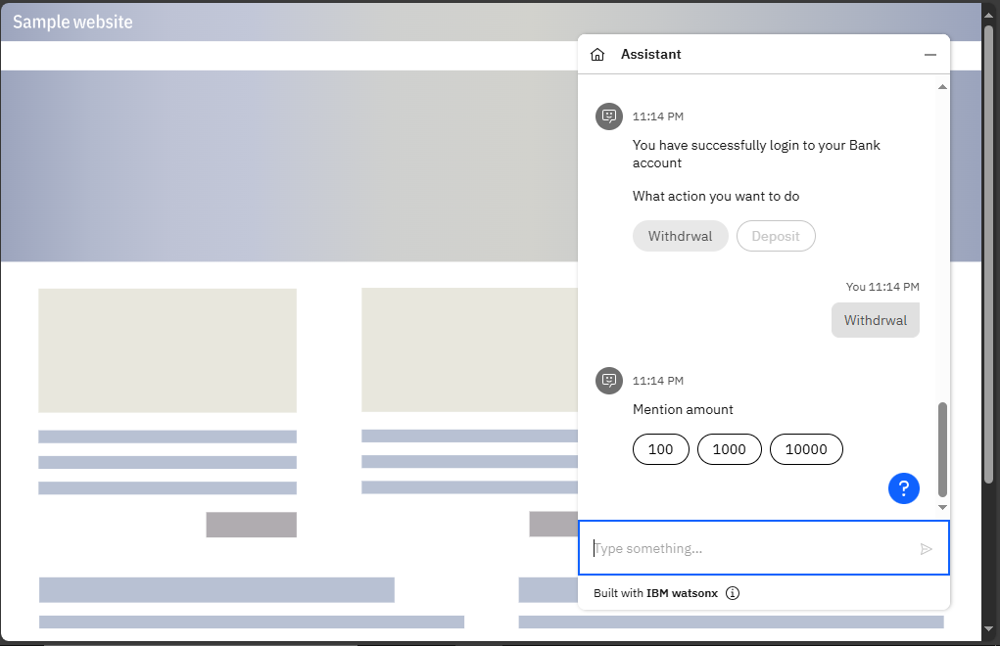
Result

Slide 12
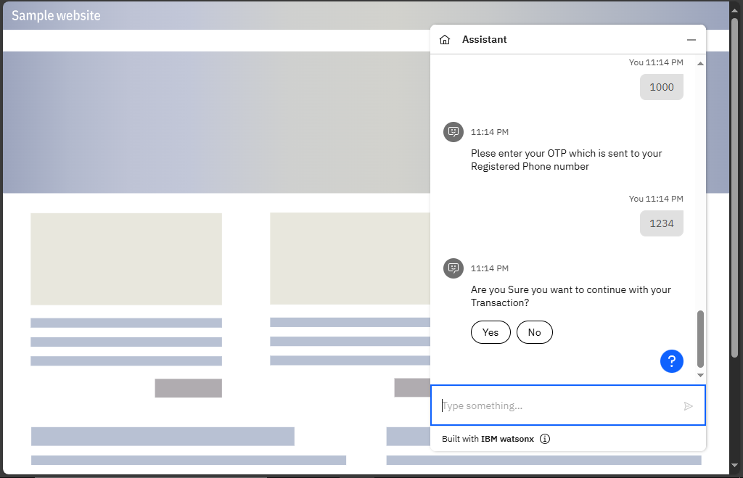
Result

Slide 13
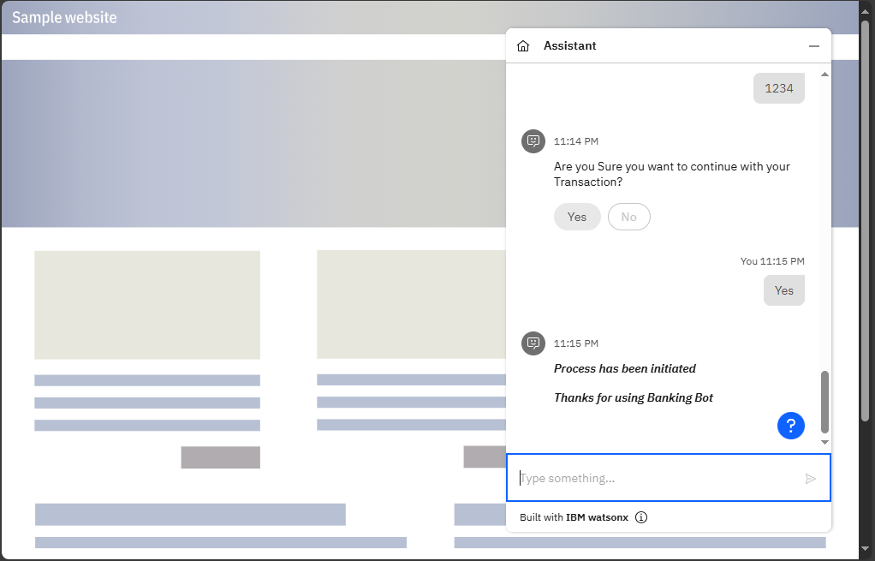
Result

Slide 14
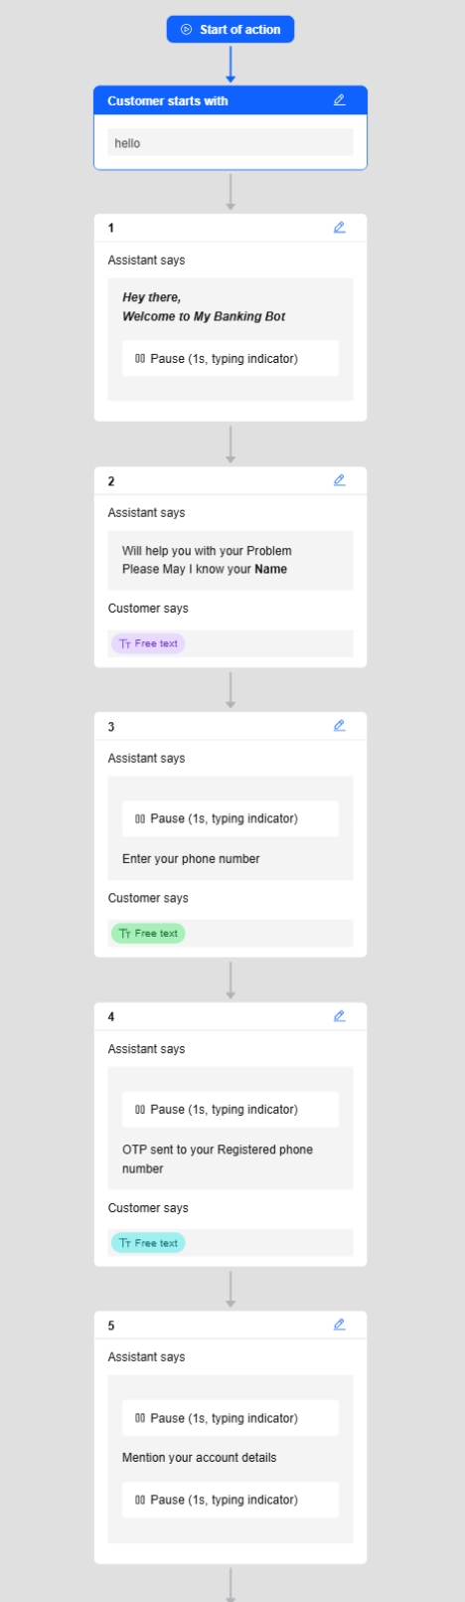
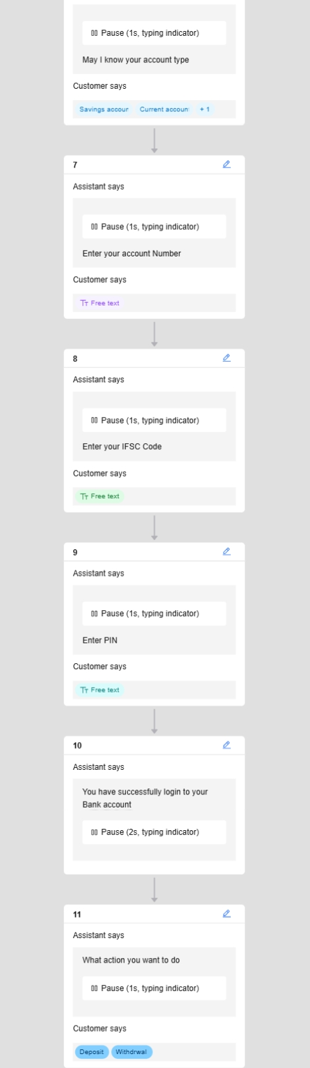
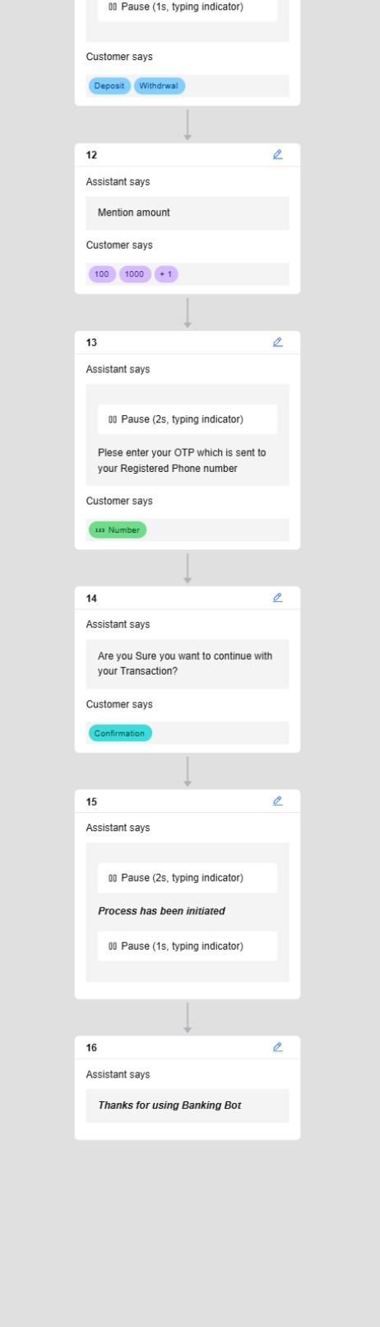
VISULIZATION

Slide 15
Conclusion
The Banking Bot project successfully revolutionizes digital banking by providing a seamless, efficient, and secure platform for deposits and withdrawals. With its user-friendly interface and 24/7 availability, the bot enhances customer experience and accessibility.
By leveraging AI and Natural Language Processing, it offers personalized assistance, ensuring quick and accurate responses to user queries. The implementation of robust security measures, such as multi-factor authentication and data encryption, ensures user data protection and builds trust.
The Banking Bot reduces operational costs for banks by automating routine transactions, while its scalable design supports future expansion into additional banking services. This project sets a new standard for digital banking, empowering users and financial institutions with innovative, reliable, and convenient solutions.

Slide 16
Future scope
Future enhancements for the Banking Bot include integrating advanced AI capabilities for more personalized financial advice and expanding multilingual support to reach a broader audience. The bot will connect with additional financial platforms and third-party services, offering users a wider range of banking options. Enhanced security features, such as biometric authentication, will improve user trust. Adding voice interaction capabilities will enhance accessibility, while implementing feedback mechanisms will enable continuous improvement. These updates will ensure the Banking Bot remains effective and adaptable in the evolving digital banking landscape.

Slide 17
References
For the development of the IBM Jobs Chatbot, several essential resources were referenced. The core technology and implementation were built using IBM WatsonX Assistant, as detailed in the IBM WatsonX Assistant Documentation. The IBM Cloud Platform Overview played a crucial role in setting up the infrastructure. These resources were instrumental in shaping the development and deployment strategies for the chatbot project.
ChatGPT
Preview Link (Banking Bot)

Slide 18
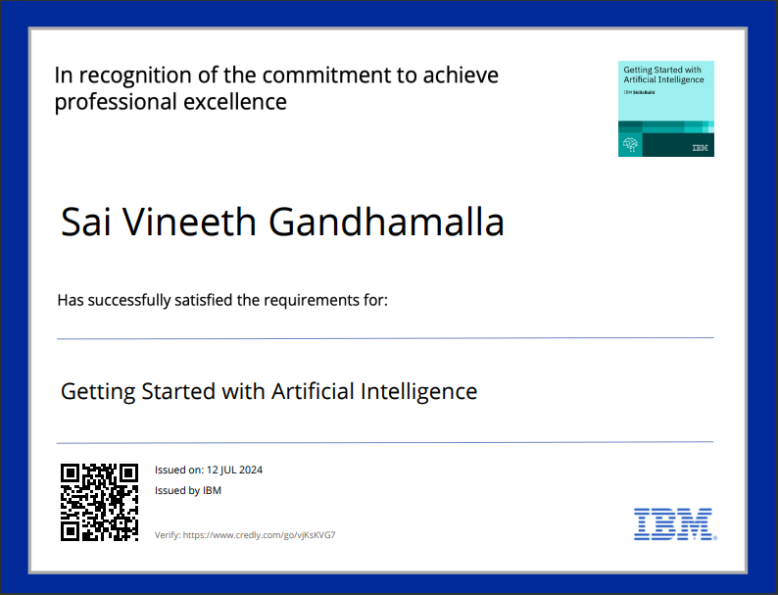
course certificate 1

Slide 19
THANK YOU

